Slide 1
For Live Session Assignment Unit 8!

Slide 2
Part 1: Quick Quiz Questions

Slide 3
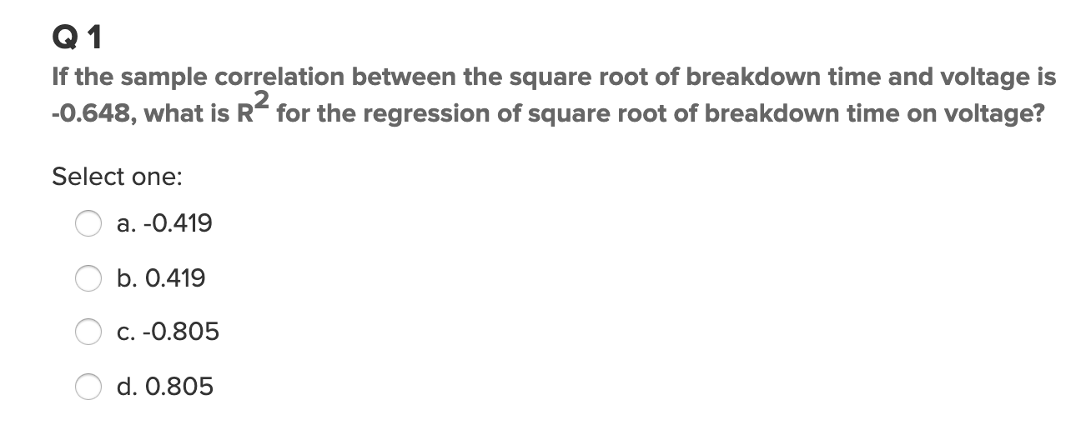
Part 1: Quick Quiz Questions

Slide 4
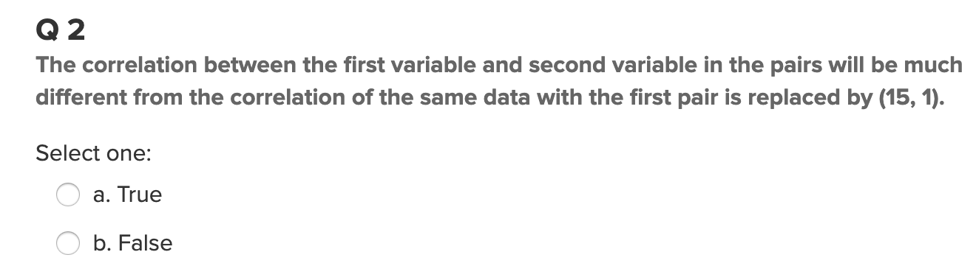
Part 1: Quick Quiz Questions

Slide 5
Part 2
Review the slides in this part to answer the question in part 3.

Slide 6
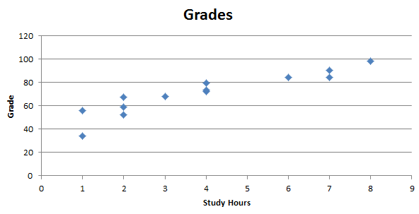
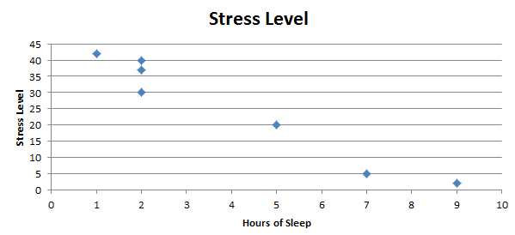
Key Concept
Examples :
Studying Hours and Grades!
Sleep v. Stress Level.
We would like a numerical measurement of the strength of the relationship between two variables representing quantitative data.
sample linear correlation coefficient: r

Slide 7
Exploring the Data
We can often see a relationship between two variables by constructing a SCATTERPLOT.
Notes:
Relate a scatter plot to the algebraic plotting of number pairs (x,y).

Slide 8
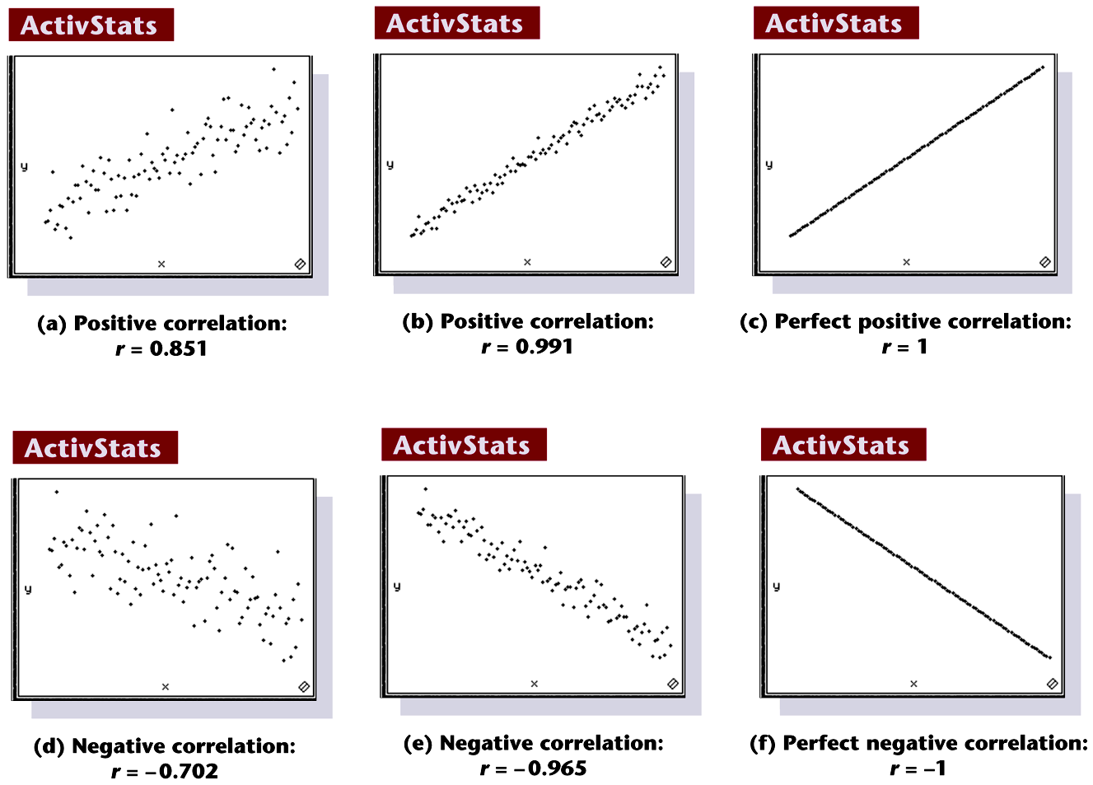
Scatterplots of Paired Data
Notes:
Page 619 of text

Slide 9
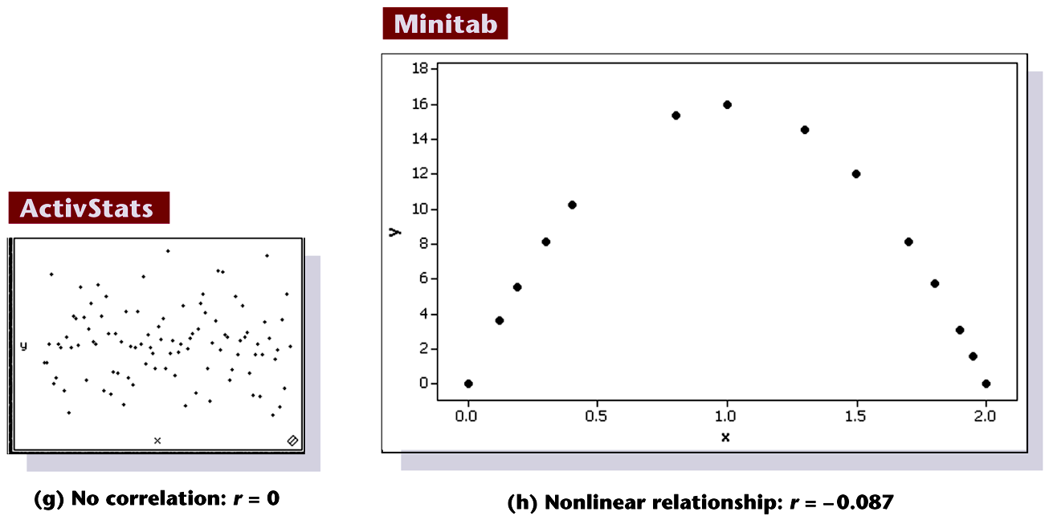
Scatterplots of Paired Data
Notes:
Page 619 of text

Slide 10
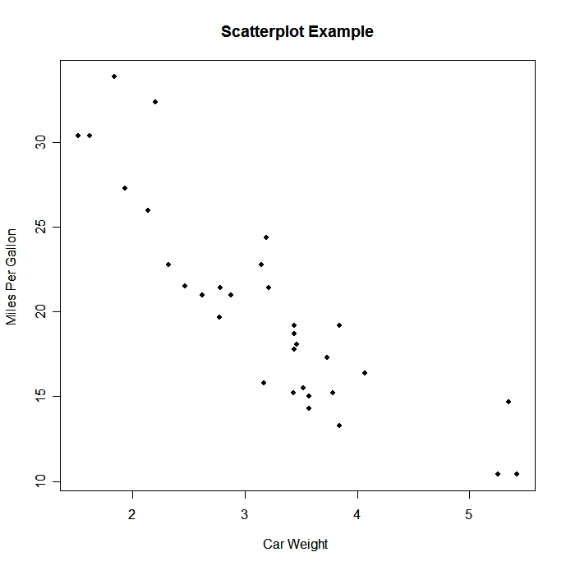

Which correlation coefficient best describes the scatter plot?
r = .32
r = 0
r = -1
r = -.78
r = -.1
r = .80

Slide 11
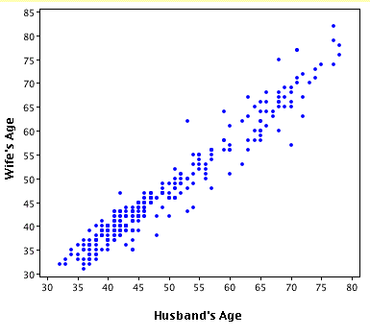
Which correlation coefficient best describes the scatter plot?
r = .32
r = -.89
r = 1
r = -.345
r = .95
r = -.5

Slide 12
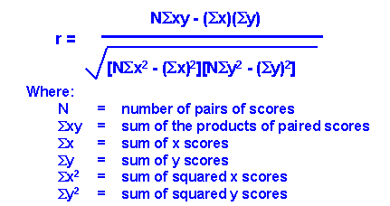
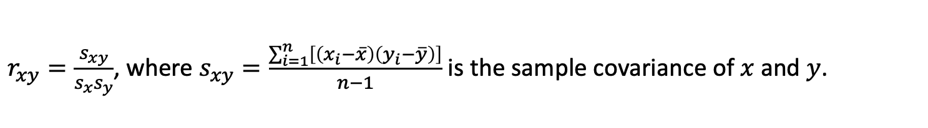
How do we find r?
$r_{xy}=\frac{s_{xy}}{s_{x}s_{y}}$, where $s_{xy}=\frac{\sum_{i=1}^{n}{\left[\left(x_{i}−\overline{x}\right)\left(y_{i}−\overline{y}\right)\right]}}{n−1}$ is the sample covariance of $x$ and $y$.

Slide 13
Properties of the Sample Linear Correlation Coefficient r
1. r measures strength of a linear relationship.
2. –1 ≤ r ≤ 1
3. The value of r does not change if the x and y variables (axes) are switched. (Try it with an example and with the formula!)
4. The value of r does not change if all values of either variable are converted linearly (new_x = a*old_x +b) to a different scale, i.e., not a nonlinear transformation like a log transformation. (Try it!)
Notes:
page 524 of text
If using a graphics calculator for demonstration, it will be an easy exercise to switch the x and y values to show that the value of r will not change.

Slide 14
Requirements
The paired (x, y) data is independent, quantitative data.
Visual examination of the scatterplot must confirm that the points approximate a straight-line pattern.
The outliers must be removed if they are known to be errors. The effects of any other outliers should be considered by calculating r with and without the outliers included.
The standard deviation of one variable should be equal across values of the other variable.
To generalize the results to a broader population, the sample should be randomly selected from the population.
In general, correlation does not imply causation. To imply causation, the subjects must be randomly assigned to different values of the independent variable. (Note that the values of the independent variable do not need to be random. For example, they could be equally spaced levels of a factor.)
Notes:
page 520 of text
Explain to students the difference between the ‘paired’ data of this chapter and the investigation of two groups of data in Chapter 9.

Slide 15
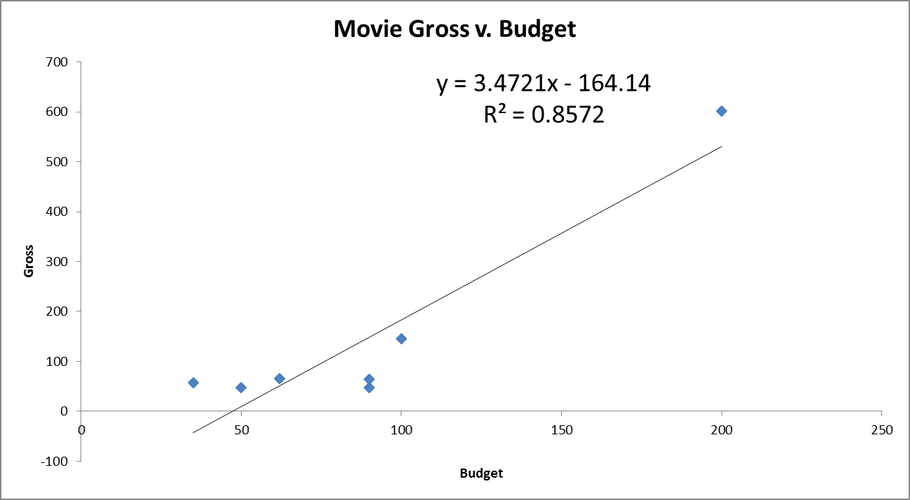
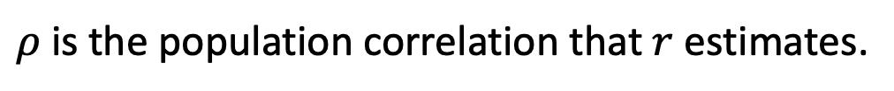
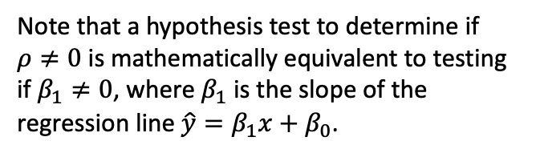
Correlation: Not resistant to outliers
$ρ$ is the population correlation that $r$ estimates.
Note that a hypothesis test to determine if $ρ≠0$ is mathematically equivalent to testing if $β_{1}≠0$, where $β_{1}$ is the slope of the regression line $\hat{y}=β_{1}x+β_{0}$.

Slide 16

Interpreting r² : Explained Variation
The metric r² is called the coefficient of determination.
The value of r² is the proportion of the variation in y that is explained by the linear relationship between x and y.
In ANOVA, $r^{2}=\frac{{SS}_{model} (top row)}{{SS}_{total} (bottom row)}$
Notes:
page 524 of text
If using a graphics calculator for demonstration, it will be an easy exercise to switch the x and y values to show that the value of r will not change.

Slide 17
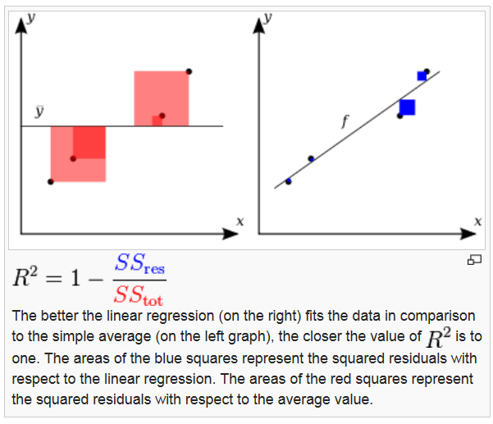
R²: comparing SS(straight line model) to SS(equal means model)

Slide 18
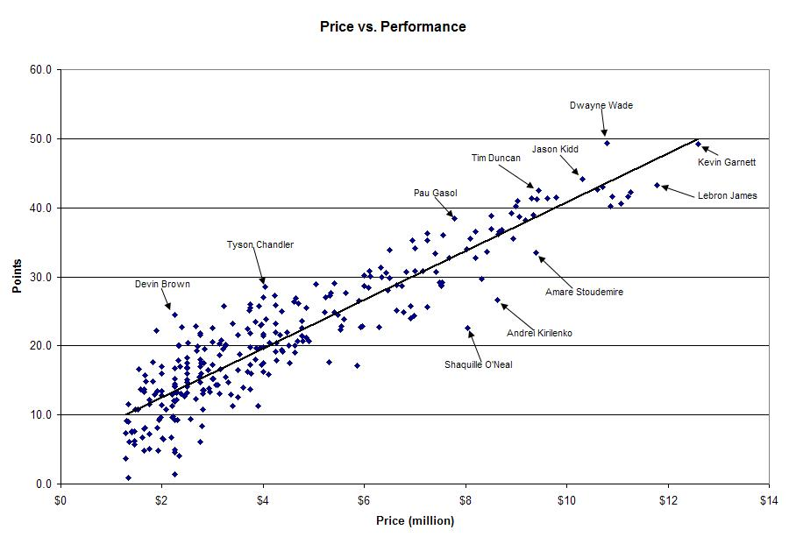
Do not confuse fewer data points with a smaller standard deviation.
r = .907
Price explains 82.3% of the variation in point production for NBA players in this year.
r² = 0. 823

Slide 19

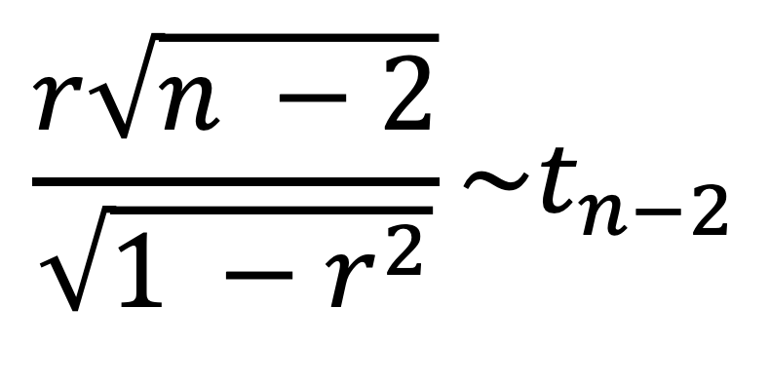
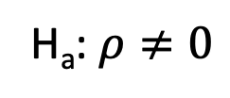
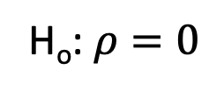
The Test Statistic!!!
$ρ$ is the population correlation that $r$ estimates.
H_{o}: $ρ=0$
H_{a}: $ρ≠0$
$$\frac{r\sqrt{n −2}}{\sqrt{1 −r^{2}}}\sim t_{n−2}$$

Slide 20
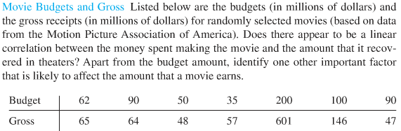
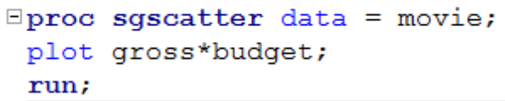
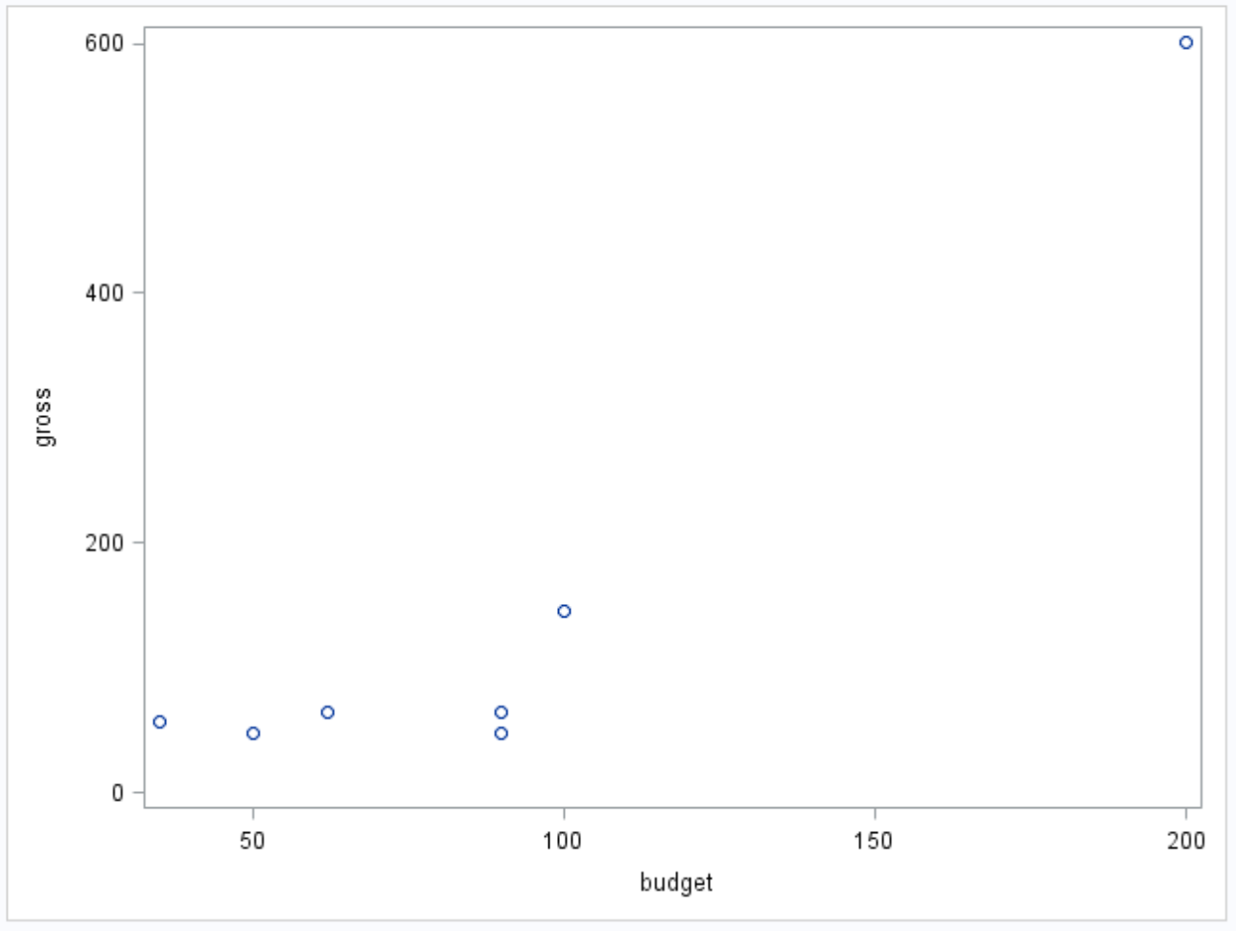
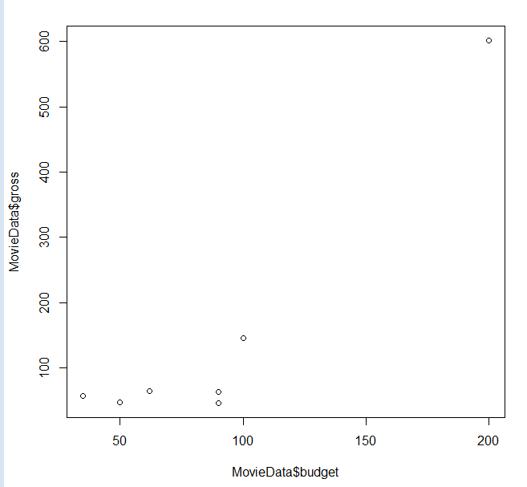
Movies!!!
Check the scatter plot to determine if a linear relationship is plausible.

Slide 21
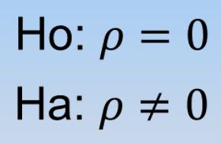
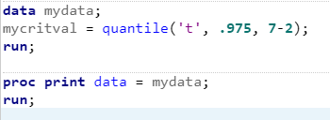

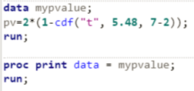


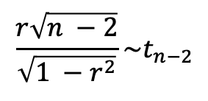
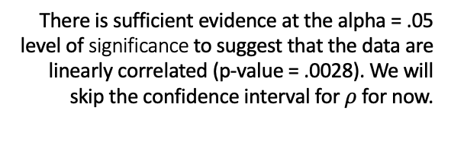
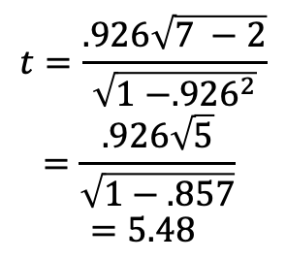
Movies!!!
$$\frac{r\sqrt{n −2}}{\sqrt{1 −r^{2}}}\sim t_{n−2}$$
There is sufficient evidence at the alpha = .05 level of significance to suggest that the data are linearly correlated (p-value = .0028). We will skip the confidence interval for $ρ$ for now.
Critical Value (use software)
$$±t_{.975, 7−2}=±2.57$$
Test statistic
It is estimated that r² = 85.7% of the variation in the Gross Sales is explained by the Movie Budget!
$$t=\frac{.926\sqrt{7 −2}}{\sqrt{1 −{.926}^{2}}}$$
$$=\frac{.926\sqrt{5}}{\sqrt{1−.857}}$$
$$=5.48$$
Because the data is randomly selected, the results can be generalized to the entire population of movies associated with the MPAA. Because the budgets were not randomly assigned, causality cannot be established, only association.
Other factors that affect gross sales may include the type of movie, the actors in the movie, etc.
P-value =.0028
(use software if the t-value is calculated “by hand”)
Reject H_{o}

Slide 22
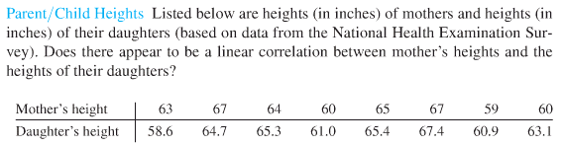
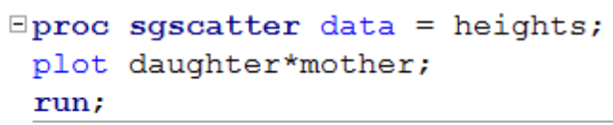
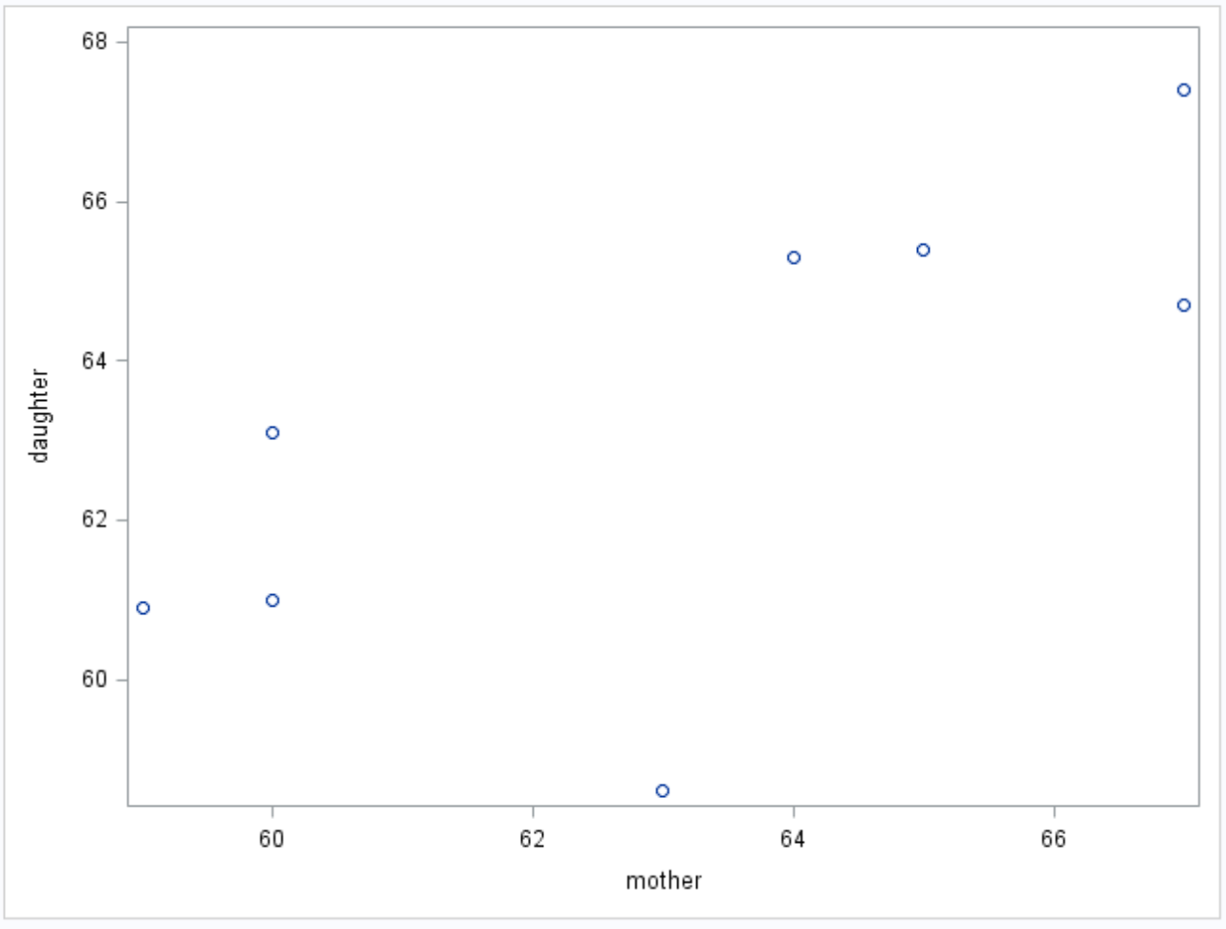
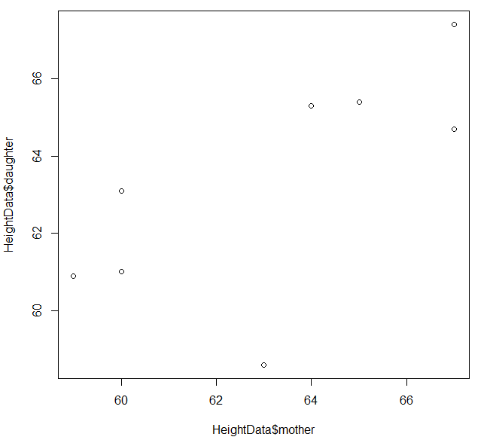
Mother/Daughter Heights
Check the scatter plot to determine if a linear relationship is plausible.

Slide 23


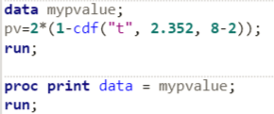
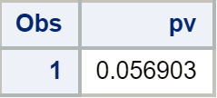
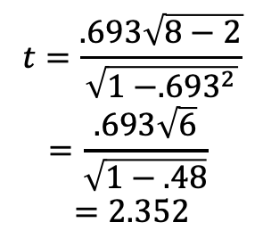

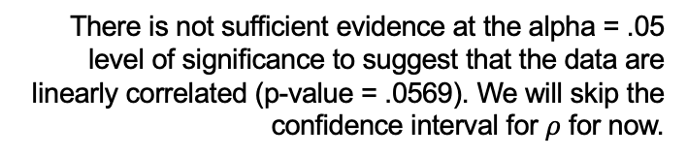
Mother/Daughter Heights
$$\frac{r\sqrt{n −2}}{\sqrt{1 −r^{2}}}\sim t_{n−2}$$
There is not sufficient evidence at the alpha = .05 level of significance to suggest that the data are linearly correlated (p-value = .0569). We will skip the confidence interval for $ρ$ for now.
Critical Value (use software)
$$±t_{.975, 8−2}=±2.45$$
Test statistic
It is estimated that r² = 48% of the variation in the Daughter height is explained by the Mother height!
$$t=\frac{.693\sqrt{8−2}}{\sqrt{1 −{.693}^{2}}}$$
$$=\frac{.693\sqrt{6}}{\sqrt{1−.48}}$$
$$=2.352$$
Because the we do not know much about how the data was sampled, the results cannot be generalized to the entire population of mothers and daughter in the NHES. Because the results are not significant, there is no need to discuss causality.
P-value =.0569
(use software if the t-value is calculated “by hand”)
Fail to Reject Ho (at alpha = 0.05)

Slide 24
Part 3
Based on the examples in Part 2, do the best you can on the next 2 questions.

Slide 25
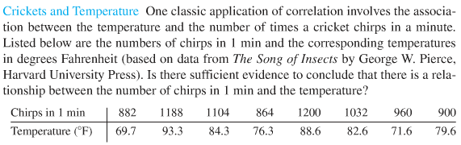
Crickets!!!
It might seem counterintuitive to predict temperature based on the number of chirps (versus the other way around), but that is the question of interest here!
(Scroll to the next slide in the reference slides window for the Movies example.)
Use SAS OR R to find r and then conduct a formal 6 step hypothesis test to test for linear correlation. You should also make note of whether a linear associations looks reasonable via visual inspection.
You should have the text file for this data but if you don’t, let the instructor know and they will provide it!
Find and interpret r².

Slide 26
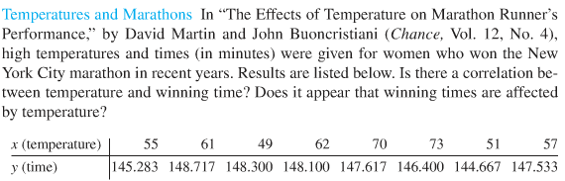
Marathons!!!
Use SAS OR R to find r and then conduct a formal 6 step hypothesis test to test for linear correlation. You should also make note of whether a linear associations looks reasonable via visual inspection.
You should have the text file for this data but if you don’t, let the instructor know and they will provide it!
Find and interpret r².

Slide 27
Part 4
Takeaways and Questions!

Slide 28
Takeaways and any Questions You May Have! Please add these to this slide and submit to 2DS! Great Job!

